Slide 1
Learning App for Kids
Presented By-
Kamelia Zaman Moon
Roll No-299

Slide 2
Definition of App-
An app is a software program running on any platform. The word “app” is an abbreviation for “application”. It's a piece of software that can run through a web browser or offline on your computer, and on a smartphone phone, tablet or other electronic devices, including smart TVs and smart-watches.
Definition of Educational App-
Educational Apps. ... Designed to anything from provide advanced study methods - such as a Flash Card app - to preventing procrastination - block the use of those apps you sink all your time into - educational apps are revolutionizing the world of education. Educational apps can create the dynamic, engaging, playful world of learning that you might not always be able to themselves.

Slide 3
Game Idea-
The app offers comprehensive learning programs in English for pre-school kids. It helps kids to learn English letters as well as poems with pictures .
Kids will also learn how to pronounce words as we have included text to speech engine.

Slide 4
Sprites & Backdrop Info-
There’ll be a starting background with a sprite.
Initialing the process the background will be changed with more sprites.
Then the background will be changed eliminating some of the sprites and importing new sprites.

Slide 5
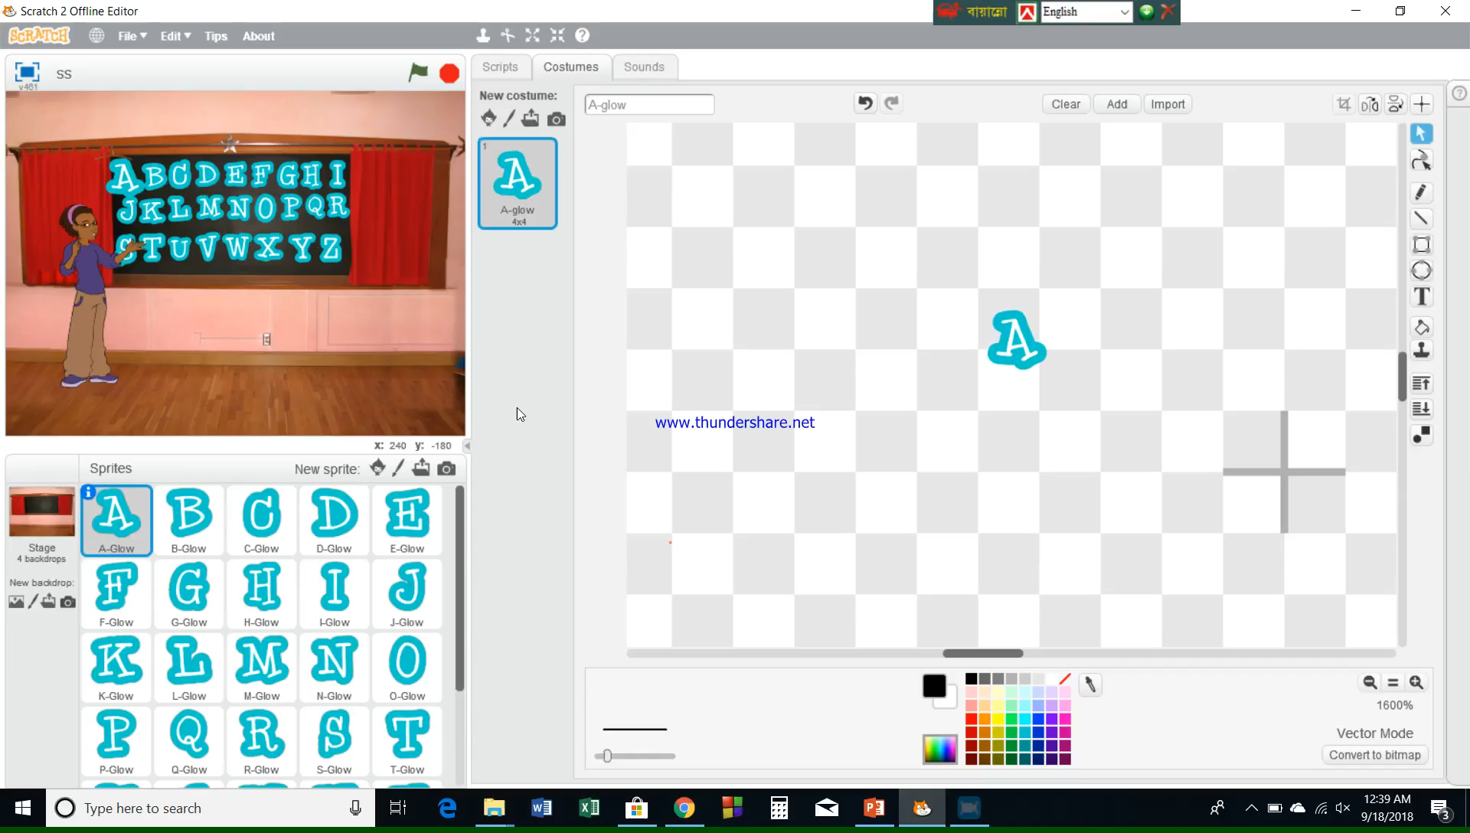
Sprites & Backdrop Info-

Slide 6
Working Process-
There’ll be alphabetical sprites & an instructor for guiding.
The instructor will show the way to use the app.
Clicking on each alphabet, the instructor will vanish and that particular alphabet will be working as the instructor.
There’ll be a name with poem based on the particular alphabet.

Slide 7
Thank You

